Slide 1

Web App Dev using Containers
Enterprise Web Dev

Slide 2

Agenda(What/Why/How of Dev containers)
What is Docker and Containers
Why use containers
What is a Dev Containers
Why use Dev Containers for App Development
What is GitHub CodeSpaces
Why use Github Codespaces
How to set up a Dev Container for Node.js
How to set up a Github Codespace for Node.js
This Photo by Unknown Author is licensed under CC BY

Slide 3
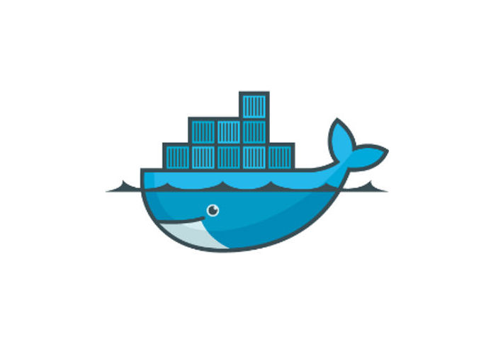
What is Docker and Containers
Debian
Ubuntu
Alpine
A container is lightweight & portable environment for developing, shipping, and running applications.
Docker is a popular platform that enables developers to create, deploy, and run applications in isolated containers.
Main components of Docker platform are:
Docker Daemon/Engine
Docker Client
Docker Containers
Docker Images
Docker Registry
Docker Engine
OS (e.g. Windows or Ubuntu)
Hardware
Notes:
Virtualisation
At the heart of Docker is the Docker engine, which is responsible for managing containers. The Docker engine communicates with the host operating system's kernel to create, start, stop, and delete containers.
Each container includes an isolated file system, network stack, and process tree, which enables it to run independently of the host system. Applications can be packaged into containers and deployed to any system that supports Docker, including local machines, cloud servers, and data centers.
Docker images are the building blocks of containers. An image is a read-only template that includes the application code and its dependencies. Multiple containers can be created from the same image, making it easy to scale applications horizontally.
Finally, Docker registries are repositories for Docker images. They allow developers to store, share, and distribute images with others. The Docker Hub is the default public registry for Docker images, but private registries can also be set up for internal use.
Overall, Docker provides a powerful platform for building and deploying applications in a scalable and portable manner.

Slide 4
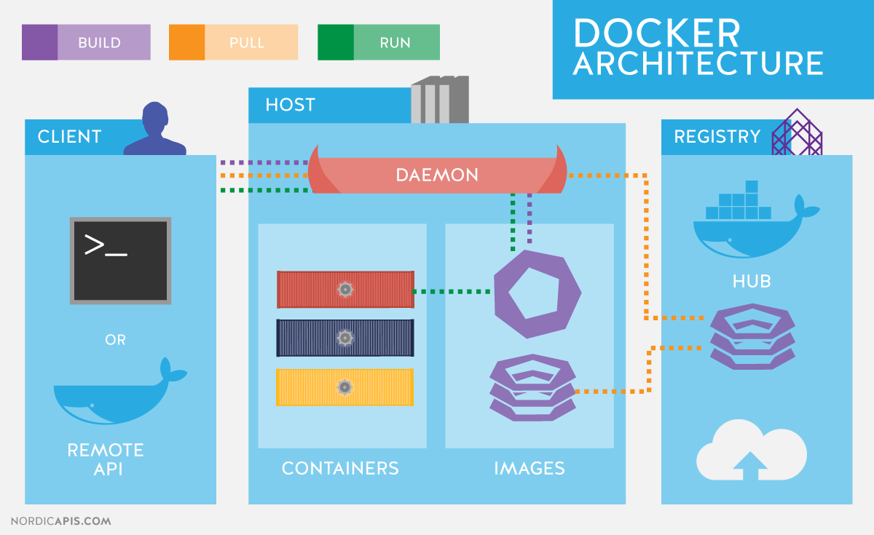
This Photo by Unknown Author is licensed under CC BY-SA
Notes:
Engine: At the heart of Docker is the Docker engine, which is responsible for managing containers. The Docker engine communicates with the host operating system's kernel to create, start, stop, and delete containers.
Images: Docker images are the building blocks of containers. An image is a read-only template that includes the application code and its dependencies. Multiple containers can be created from the same image, making it easy to scale applications horizontally.
Containers: Each container includes an isolated file system, network stack, and process tree, which enables it to run independently of the host system. Applications can be packaged into containers and deployed to any system that supports Docker, including local machines, cloud servers, and data centers.
Registry: Finally, Docker registries are repositories for Docker images. They allow idevelopers to store, share, and distribute images with others. The Docker Hub is the default public registry for Docker images, but private registries can also be set up for internal use.
Overall, Docker provides a powerful platform for building and deploying applications in a scalable and portable manner.

Slide 5
Docker File

Slide 6
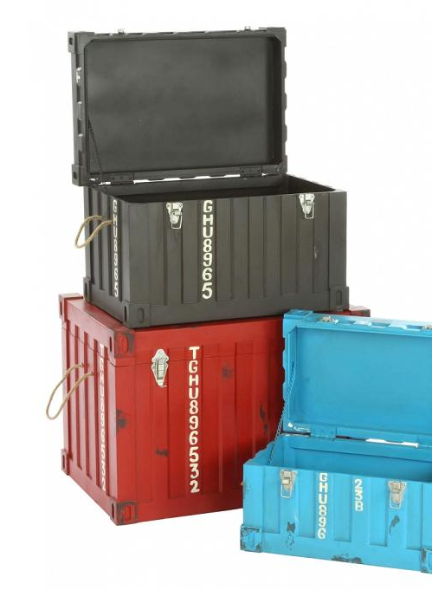
Why use Containers
A consistent environment for development, testing, etc which reduces the risk of issues due to differences between environments.
Concurrently develop different versions of an application and/or its dependencies without affecting the underlying system.
Containers can be spun up and down quickly as needed.
Efficient use of resources.
You can run multiple containers on a single machine, reducing the need for additional hardware.
Containers can be scaled up or down easily
Popular technology for web application development.
Easy to Share/deploy Applications.
(I should have no problem running/testing your labs and API!)
This Photo by Unknown Author is licensed under CC BY-SA-NC

Slide 7
How to use Containers(docker)
Install docker on your local machine
Use the "docker build" command to build the Docker image using the dockerfile
May take a while 1st time
Use "docker run" command to start a Docker container based on the image.
Configure the container to expose certain ports, mount local volumes, or set environment variables
Notes:
DEMO
Install Docker: Visit the official Docker website and download the appropriate version of Docker for your operating system.
Verify Docker installation: Open a terminal or command prompt and type "docker version" to confirm that Docker is installed and running properly.
Create a Dockerfile: A Dockerfile is a text file that contains the instructions to build a Docker image. You can create a Dockerfile using a text editor of your choice.
Build the Docker image: Use the "docker build" command to build the Docker image using the Dockerfile you created. This process may take some time, depending on the size of the image and the speed of your internet connection.
Run the Docker container: Once the Docker image is built, you can use the "docker run" command to start a Docker container based on the image.
Configure the Docker container: Depending on your needs, you may need to configure the Docker container to expose certain ports, mount local volumes, or set environment variables. You can do this using the "docker run" command or by modifying the Dockerfile.

Slide 8
What are Dev Containers
Dev containers are preconfigured containers for App Development and Testing
Designed to work well with VS Code and Github
They include tools/libraries/dependencies specifically tailored for a project
For Node.js Development:
https://github.com/nodejs/devcontainer
This container has Node.js, JavaScript, and Typescript. It also includes a common set of tools, such as nvm, npm, yarn, git, wget, rsync, openssh, and nano. Also, you can easily build and connect to it using VS Code.

Slide 9
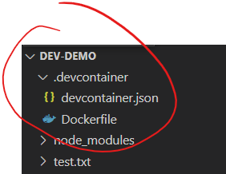
Using a Dev Container(Local Host)
Install Docker on Local Host
Create a folder for your app on your local host (e.g. my-app)
Create a .devcontainer folder in your my-app folder
Create a "Dockerfile“ in the .devcontainer folder
Create a "devcontainer.json" in the .devcontainer folder. This file will define the configuration for your dev container.
Open your my-app folder in Visual Studio Code and install the “Dev Containers" extension
Select “Open Remote Window” in bottom left corner. Select “Reopen in Container” option from Dev Containers list.
OR (much easier…)
Just use VS Code to create a Dev Container for you…

Slide 10
Why Use a dev container
Consistency across development environments
Isolation from the host machine
Easy setup and configuration
Ability to replicate the same environment for development, testing, and production

Slide 11

What is github Codespaces
GitHub Codespaces lets you create a cloud-based development environment that can be accessed from anywhere.
GitHub Codespaces are built on top of dev containers
All in the cloud!
Subset of VS Code IDE in Browser if you want

Slide 12
Why use Github codespaces
Code on any device, anywhere. (e.g. new laptop?... get going with dev straight away. No local env set up.)
Easy collaboration with others
Auto synchronisation with GitHub repo…

